Slide 1
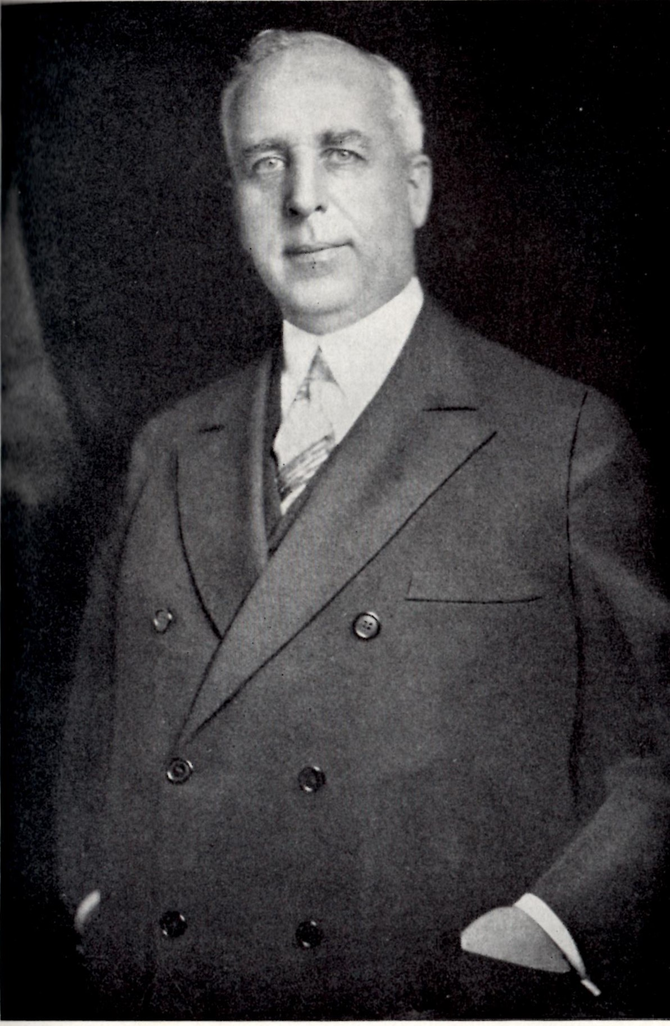
Paul W. Litchfield
An American Industrialist in Arizona

Slide 2
We are the Litchfield Park Historical Society
THE LITCHFIELD PARK HISTORICAL SOCIETY'S MISSION STATEMENT
"To connect generations by fostering an understanding and appreciation of the history, arts, and culture of the Southwest Valley."
THE LITCHFIELD PARK HISTORICAL SOCIETY'S VISION STATEMENT
"To be the historical and cultural heart of the Southwest Valley."

Slide 3
Paul W. Litchfield: An American Industrialist in Arizona
Lesson Plan
Learning Objectives
Students will be able to discuss the life of Paul W. Litchfield, an influential industrialist of the early to mid- 20th century.
Students will identify key information from a video about Paul Litchfield.
Students will demonstrate what they learned about Paul Litchfield and his influence in Arizona through an extension activity.

Slide 4
Paul W. Litchfield: An American Industrialist in Arizona
Arizona Standards Addressed
● 3.H1.1 Utilize a variety of sources to construct a historical narrative exploring Arizona’s cultures, civilizations, and innovations.
• Key concepts include but are not limited to impact of prehistoric peoples, Native Americans, Latinx, African Americans, Asian Americans, and newcomers from the United States and world on art, language, architecture, mining, agriculture, and innovations.
• Influential individuals and groups in the history and development of Arizona.

Slide 5
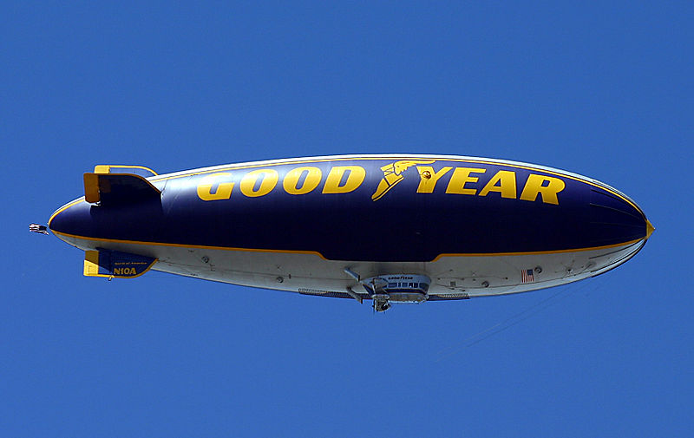
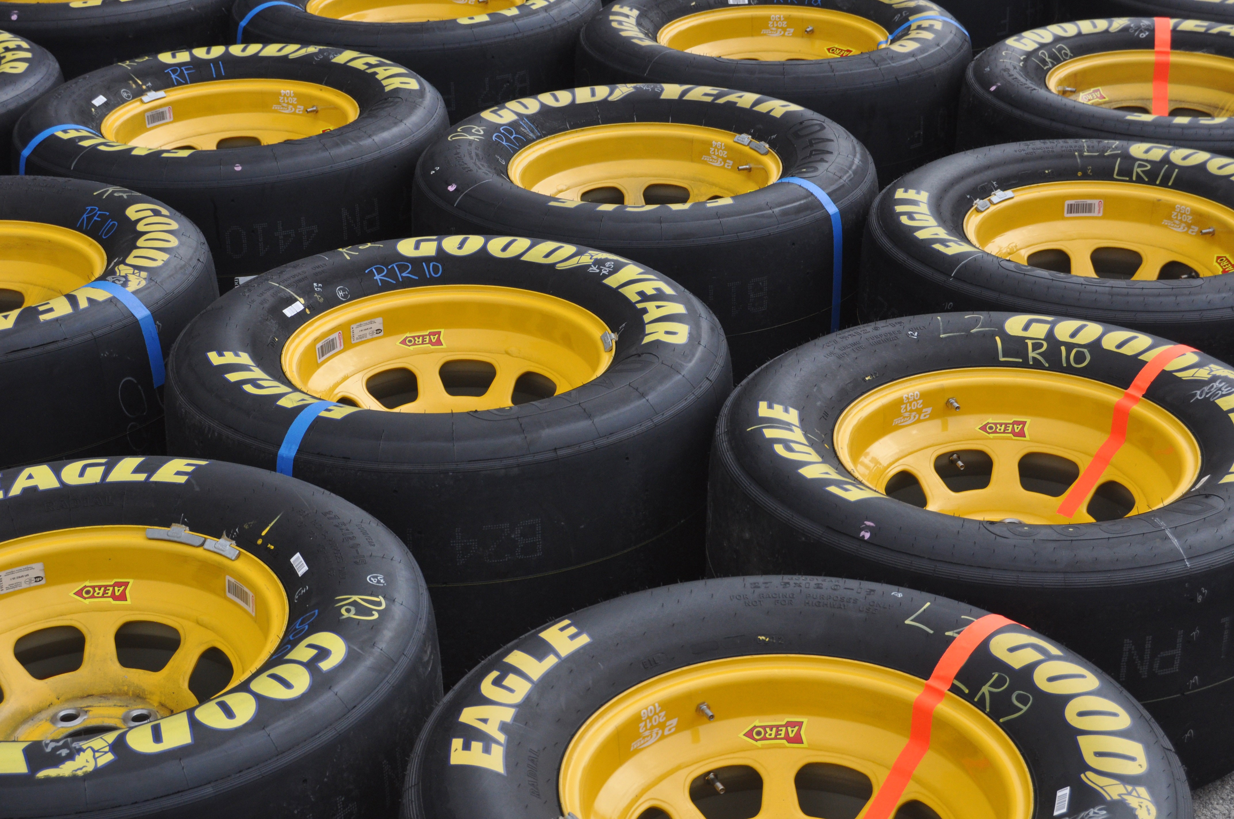
Paul W. Litchfield: An American Industrialist in Arizona
Introduction
Goodyear Tire and Rubber Company was started in 1898 and has made rubber tires and many other products including blimps.
This Photo by Unknown Author is licensed under CC BY-SA
This Photo by Unknown Author is licensed under CC BY-SA

Slide 6
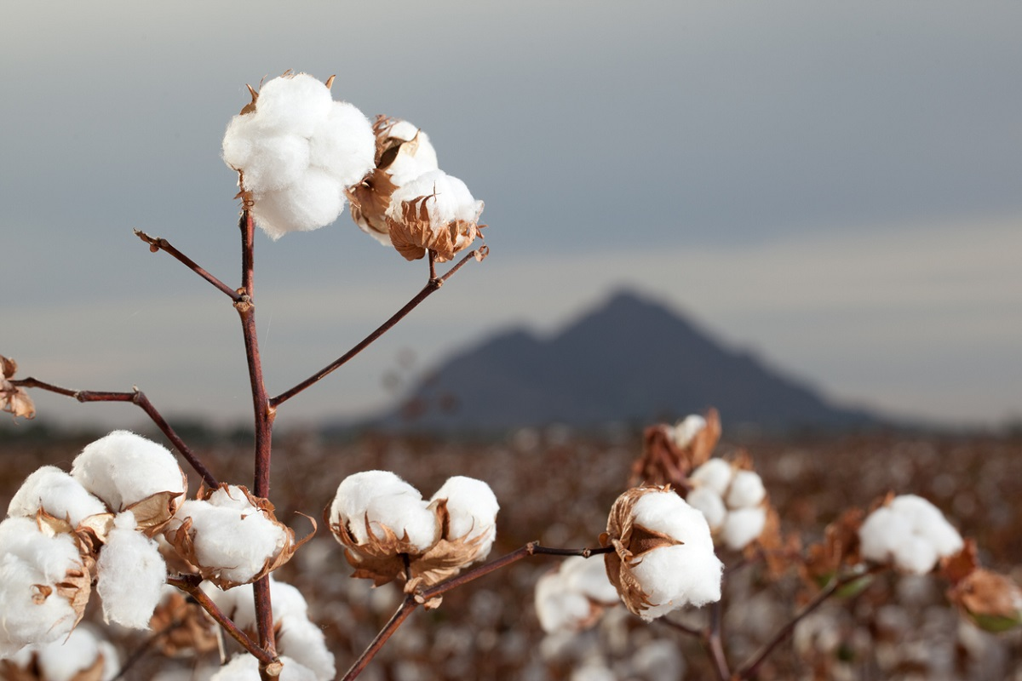
Paul W. Litchfield: An American Industrialist in Arizona
Introduction continued
Early rubber tires relied on the use of natural ingredients such as rubber from rubber trees and cotton from cotton fields.
The Goodyear Tire & Rubber Co set up operations in Arizona to grow cotton for their tires and other agricultural products, manufacture other products, and test equipment, such as tractor tires.
This Photo by Unknown Author is licensed under CC BY-NC-ND

Slide 7
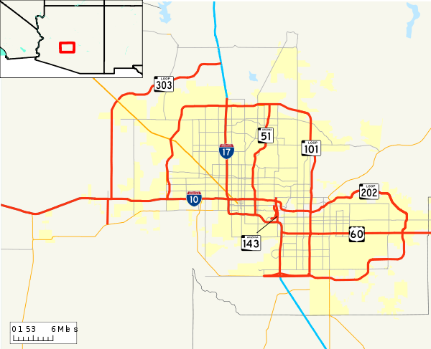
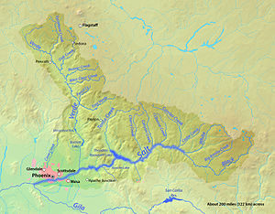
Paul W. Litchfield: An American Industrialist in Arizona
Introduction Continued
Phoenix and its surrounding cities are located in the Salt River Valley. Litchfield Park and Goodyear are areas where much of the cotton was grown for Goodyear Tire & Rubber Co.
Cotton is grown in Arizona’s low deserts. The Goodyear Tire & Rubber Co mostly grew cotton in the southwest area of the Salt River Valley.
Cotton is one of Arizona’s five Cs (copper, cattle, cotton, citrus, & climate)
This Photo by Unknown Author is licensed under CC BY-SA
This Photo by Unknown Author is licensed under CC BY-SA

Slide 8
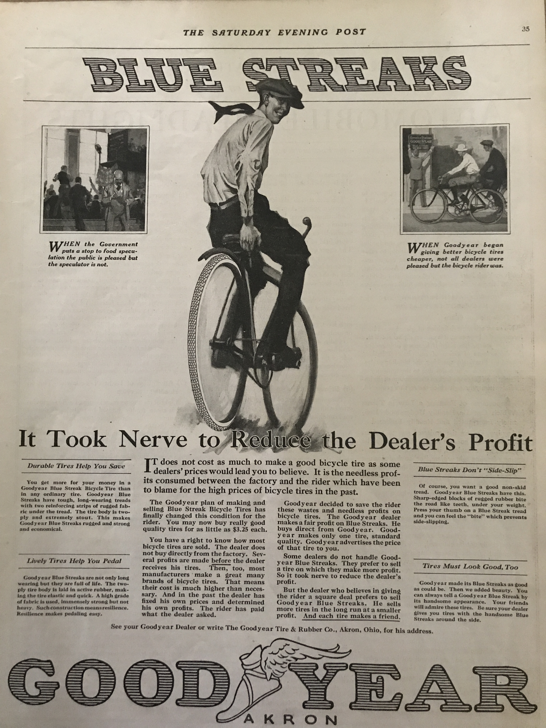
Paul W. Litchfield: An American Industrialist in Arizona
Introduction Continued
Rubber companies had been developing air-filled tires since the 1890s. They started by making tires for bicycles and horse-drawn carriages. They later made air-filled tires for automobiles and needed to find a way to make tires more durable.
Rubber companies use more man-made ingredients in tire making today and no longer need cotton in tires.

Slide 9
Paul W. Litchfield: An American Industrialist in Arizona
Essential Questions
What does it mean to leave a legacy?
What is research and how can it help solve a problem?
Who was Paul Litchfield and what is he known for?
How did Paul Litchfield and Goodyear Tire & Rubber Co influence agriculture in Arizona?

Slide 10
Paul W. Litchfield: An American Industrialist in Arizona
Vocabulary
Transform: to change the form, look, or shape of
Horse-drawn carriage: a vehicle with wheels used to carry people and pulled by a horse
Promote: to move to a higher position
Researcher: someone who does careful study of something in order to gain information or solve a problem
Boll weevil: a small beetle with a gray body and a long snout. It lays eggs in the seed pods of the cotton plant where they hatch and cause damage to the plant.

Slide 11
Paul W. Litchfield: An American Industrialist in Arizona
Vocabulary
Profit: the amount of money a business makes that is more than the cost of making the item that will be sold.
Boom: a great increase in something, like an item everyone wants to buy
Crash: a large decrease in what people want to buy
Alfalfa: a plant with purple flowers grown as food for cattle and horses.
Conserve: to protect, to use in amounts that are no more than necessary in order to avoid waste.

Slide 12
Paul W. Litchfield: An American Industrialist in Arizona
Vocabulary
Testing ground: a place where new equipment or machines can be tried out to see how well it works
Terrain: land or ground, or the natural characteristics of its surface.
Blimp: an aircraft that holds it shape and flies because it is filled with a gas that is lighter than air.
Radar: the use of radio waves to track the location, distance, and speed of faraway objects.
Patent: a government grant that gives someone the right to make, use, or sell an invention.
Legacy: something that is passed down from ancestors or someone who came before. It can be things like money and possessions, or things that influence future ideas, values, heritage, or tradition.

Slide 13
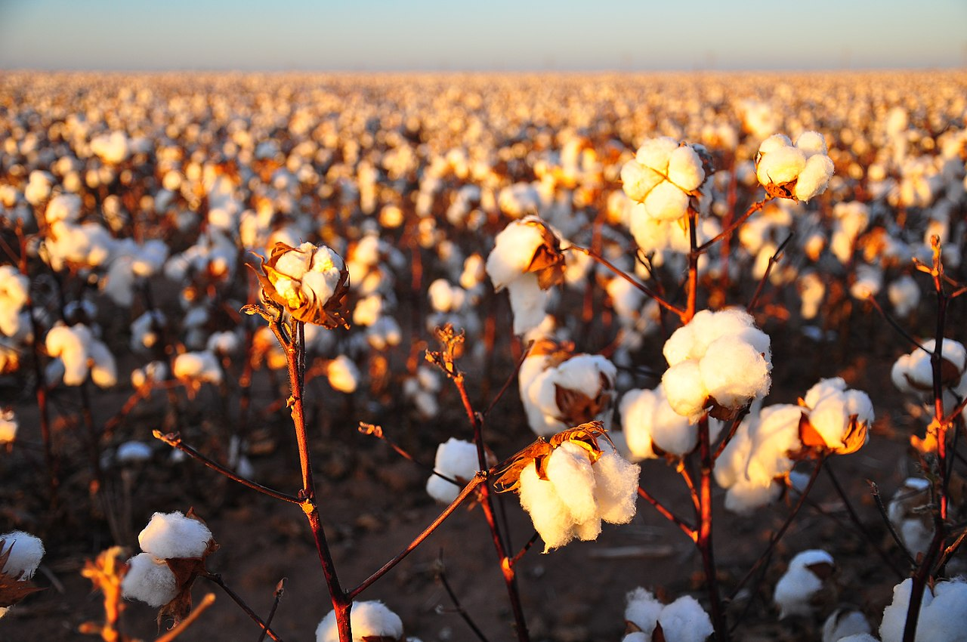
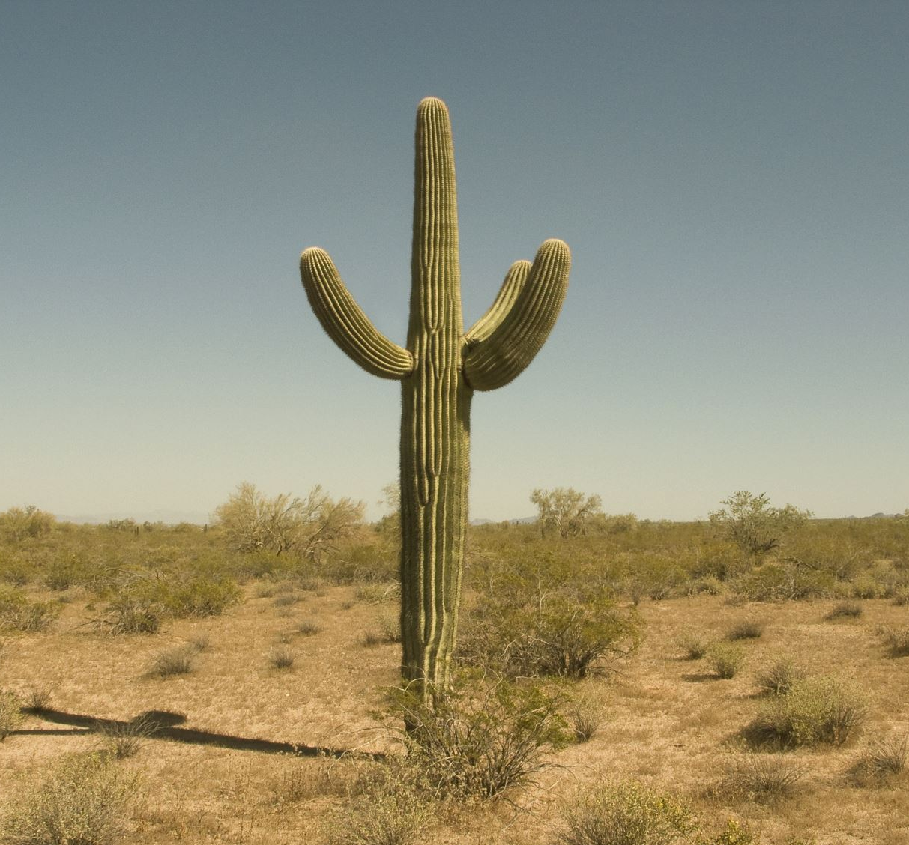
Paul W. Litchfield: An American Industrialist in Arizona
Warm up
COPPER
CATTLE
COTTON
CITRUS
CLIMATE

Slide 14
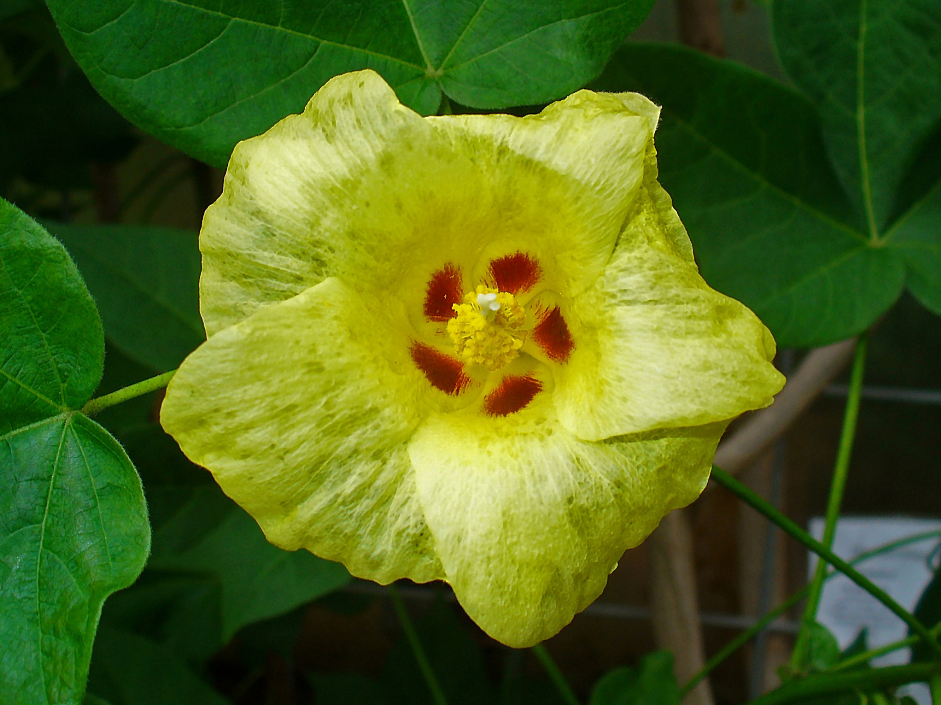
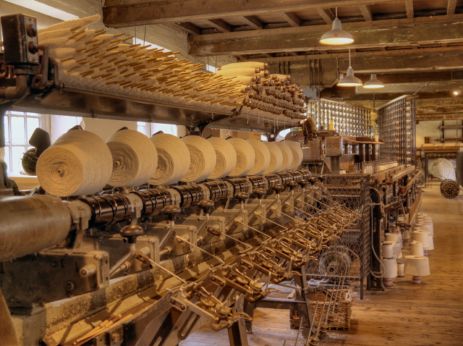
Paul W. Litchfield: An American Industrialist in Arizona
This Photo by Unknown Author is licensed under CC BY-SA

Slide 15
Paul W. Litchfield: An American Industrialist in Arizona

Slide 16
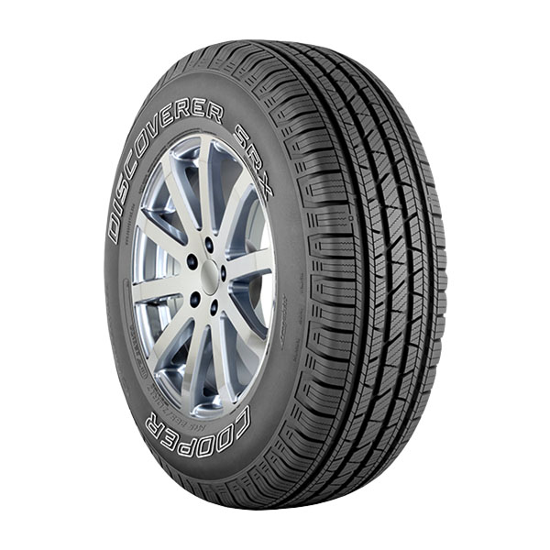
Paul W. Litchfield: An American Industrialist in Arizona
This Photo by Unknown Author is licensed under CC BY-NC-ND
Rubber Tree

Slide 17
Paul W. Litchfield: An American Industrialist in Arizona
Opening Questions
Have you ever had a problem you needed to solve?
What does it mean to come up with a solution to a problem?

Slide 18
Paul W. Litchfield: An American Industrialist in Arizona
Resources
The video “Paul W. Litchfield ” is available at
https://youtu.be/ouoln07D4UY

Slide 19
Paul W. Litchfield: An American Industrialist in Arizona
Extension Activities
Write a letter to a family member telling them who Paul Litchfield was and what you learned about him.
Create a poster with a drawing of something related to Paul Litchfield and the problems he solved. Write a caption listing three things he did below your drawing.
Paul Litchfield invented many things to solve problems. What is something you would invent to solve a problem? Draw a picture of your invention, explain what problem it solves, and how it works.

